Slide 1
IsDS 3105 Group 3
By: TANIA TRINH
JASON WILLIAMS
BUFORD DEAN
Project artifact: html

Slide 2
Research questions
How much does having an internship affect your starting salary?
Does it matter if the internship is related to the respective major? / Are those that get internships more likely to choose a post grad job related to their major?
How much does one internship differ from many?

Slide 3
Data for graduates, internships, & wages
In order to create a table presenting the correlation between graduates, internships, and their wages (hourly wage), we used a filter to join/(left join) (‘graduation’, ‘internship’, ‘paidInternship’) with the hourly wages while filtering out any results that have NA for that column, sorting the results in an ascending order.
The following table is an example of the results; variables include: internshipId, completionDate, jobTitle, hoursPerWeek, numberWeek, academicCredit, internshipPaid, graduationId, internshipSupervisorId, locationId, & organizationId.
# Source: table<internship> [?? x 11]
# Database: mysql 5.6.19-log [student@ba-isdsclass-programdev.lsu.edu:/isds_3105]
internshipId completionDate jobTitle hoursP… number… academ… intern… gradu… internsh… locat… organi…
<int> <chr> <chr> <chr> <chr> <chr> <chr> <int> <int> <int> <int>
1 709 Fall 2014 IT Securit… NA NA ISDS Yes 1 NA NA 549
2 710 summer 2014 hardware a… NA NA NA Yes 3 NA NA 2822
3 711 Fall 2013 Intern NA NA NA Yes 4 487 NA 3140
4 712 FALL 2014 ENGINEER NA NA NA Yes 8 488 NA NA
5 713 Fall 2014 Tiger Inte… NA NA NA Yes 9 NA NA 4402
6 714 Fall 2013 Farm assis… NA NA ANSC 2… No 11 NA NA 1407
7 715 Summer 2011,2013,2014 Facilities… NA NA NA Yes 13 NA NA 1509
8 716 Summer 2013-Present Marketing … NA NA NA Yes 15 489 NA 2842
9 717 Current Intern NA NA Kin 48… Yes 16 NA NA 2842
10 718 Fall 2014 Intern NA NA NA Yes 19 NA NA 78
# ... with more rows

Slide 4
“Dirty” data
We have realized that there is a large sum of "dirty" data, and thus did some cleanup. Some hourly wages appear to be above $40-$45, which seems very unreasonable for even out of state internships in high cost-of-living states such as California. That being said, we filtered out the results greater than $40/h.
The following table was thus created:
# Source: lazy query [?? x 5]
# Database: mysql 5.6.19-log [student@ba-isdsclass-programdev.lsu.edu:/isds_3105]
# Ordered by: graduationId
internshipId jobTitle graduationId weeklyCompensation hourlyWage
<int> <chr> <int> <dbl> <dbl>
1 709 IT Security Intern 1 113 8.00
2 5115 IT Analyst Intern 1 610 15.0
3 5116 Intern 4 222 22.0
4 5118 Marketing Intern 15 600 15.0
5 5120 Civil Engineering Intern 31 100 10.0
6 723 Intern 36 220 11.0
7 5121 Intern 37 960 24.0
8 5122 Grad Assistant 40 1480 37.0
9 727 Key Holder 43 240 16.0
10 5123 Assistant Researcher to.. 47 200 10.0
# ... with more rows

Slide 5
Number of internships per student
We also decided to (count) the internship amounts for each given student as a data frame, which resulted in a tibble with 3,179 rows and two columns consisting of variables, ‘graduationId’ and ‘count’ (number of internships per student).
We proceeded by creating a new variable (countCOUNT) representing the amount of students with 1 internship, 2 internships, or 3 internships, respectively. The tibble below represents our results.
A tibble: 3 x 2
count countCOUNT
<int> <int>
1 2408
2 630
3 3 141

Slide 6
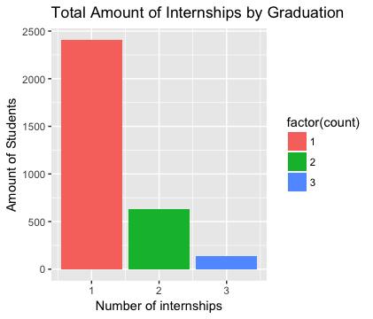
Bar graph of the total amount of internships per student

Slide 7
How does the salary differ between each amount of internship(s)?
In this step, we wanted to get the salaries from students with internships based on their current positions (curPos), employment (employ), and their status as a full-time employee (full_time).
The following tibble (internSalary) is a result of right joining ‘curPos’ by ‘graduationId’ & left joining ‘employ’ and ‘full_time’ by ‘idCurrentPosition’, and filtering out any NA results:
# A tibble: 1,090 x 3
graduationId count salary
<int> <int> <dbl>
1 1 2 65000
2 36 1 58000
3 37 1 72500
4 40 1 40500
5 61 2 95000
6 93 2 32000
7 94 1 70000
8 99 2 44000
9 150 3 74000
10 155 2 74500
# ... with 1,080 more rows

Slide 8
Students without internships
We also decided to hold students WITHOUT internships in our project to show the effect of not having an internship in correlation with their average salaries.
Using the current position (currentPos), employment (employment2), and salary (salary) variables we decided to right join (curPos) by ‘graduationId’ & left joining (employ) and (full_time) by ‘idCurrentPosition’ thus giving us a tibble of the results below.
# A tibble: 2,335 x 3
graduationId count salary
<int> <int> <dbl>
1 13 NA 72000
2 27 NA 44000
3 29 NA 44000
4 30 NA 55000
5 33 NA 15000
6 56 NA 50000
7 78 NA 36000
8 80 NA 35000
9 82 NA 46000
10 88 NA 40000
# ... with 2,325 more rows

Slide 9
Results
Using the variables pos (current position), em (employment), sal (salary), we decided to right join the variable used earlier (curPos) by ‘graduationId’, followed by left joining the variables (employ & full_time) by ‘idCurrentPosition’; filtering out any NA results, we grouped by the (count) of the results followed by summarizing our results in order to obtain the mean (avgSalary) of our results.
Thus, resulting in the following tibble:
# A tibble: 4 x 2
count avgSalary
<dbl> <dbl>
1 1.00 49241
2 2.00 55858
3 3.00 58504
4 0 48296

Slide 10
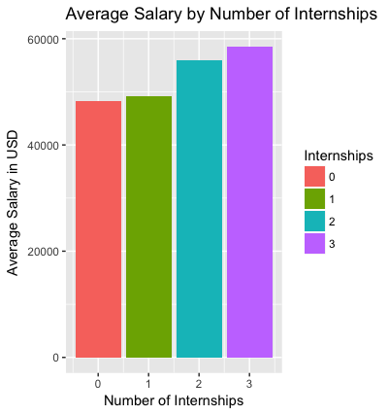
Results (graphed)
sal[is.na(sal)] <- 0

Slide 11
Results (cont)
As per the graphs, we can see that there is not a substantial change from having no internships to having one, but the difference between 0 to 2/3 is pretty large. Someone with 3 internships will make $`r round(difference)` more on average, which is a `r difference/sal$avgSalary[4] * 100`% increase. [10208]

Slide 12
Salaries relating to respective majors
Does it matter if the internship is related to the respective major?
In order to obtain the results of this question, using our em (employment) variable we left joined ‘full_time’ by ‘idCurrentPosition’, followed by filtering out any NA results from our selected variables (specifically including the variable ‘relatedToMajor’) grouping the results by (count) & (relatedToMajor).
Thus giving us the following tibble:
# A tibble: 759 x 4
# Groups: count, relatedToMajor [11]
graduationId count salary relatedToMajor
<int> <int> <dbl> <chr>
1 1 2 65000 Directly related
2 36 1 58000 Directly related
3 37 1 72500 Somewhat related
4 40 1 40500 Somewhat related
5 61 2 95000 Directly related
6 93 2 32000 Directly related
7 94 1 70000 Directly related
8 99 2 44000 Directly related
9 150 3 74000 Directly related
10 155 2 74500 Somewhat related
# ... with 749 more rows

Slide 13
Salaries relating to respective major (graphed w/ internship count (fill))

Slide 14
Salaries related to respective major (graphed w/o fill)
major[is.na(major)] <- 0

Slide 15
Conclusion

